Slide 1
What to expect: Discussions of expecting mothers in the United States
Web Scraping Project
April 23, 2019
By Julie Kim

Slide 2
Background information
3.8 million-plus newborns in the United States in 2017 (National Center for Health Statistics 2018 report)
60 births per every 1,000 women ages 15 – 44 years
30-year low and down 2 % from 2016
WhatToExpect.com
13 million moms
800,000 new posts each moth

Slide 3
Purpose
Where are WTE users mostly located?
What do expecting mothers talk(concerned) about?
Do expecting mothers’ topics of discussions change over time?

Slide 4
Procedure
https://community.whattoexpect.com/forums/
Select a forum organized by locations in the United States
Collect data on all locations with the number of members and posts
Collect data on all posts titles, number of replies per post, and the time of last reply (last updated time)
Selenium, Python, Excel

Slide 5
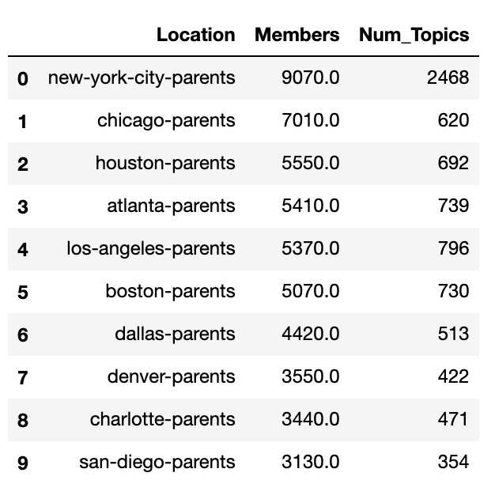
Top 10 Locations By Most Members

Slide 6
Number of Members by Locations

Slide 7
Number of Discussions by Locations

Slide 8
Top Topics with Most Members
Location | Top Topics
New York City | Fellow Pregnant Women Subway Seats Hospital and OB-GYN Recommendations (Lenox Hill, Weill Cornell, Mt. Sinai, NYU) Doula Service Daycare
Chicago | Fellow Pregnant Women Hospital and OB-GYN Recommendations (University of Chicago, Lutheran) Daycare/Nanny
Houston | Fellow Pregnant Women Hospital and OB-GYN Recommendations (Women’s Hospital of Texas) Daycare Jobs Daycare/Nanny

Slide 9
Top Topics with Most Number of Topics
Location | Top Topics
New York City
Los Angeles | Fellow Pregnant Women Hospital and OB-GYN Recommendations Health Insurance/Cost Midwife First-time Expecting Moms Maternity Clothes
Atlanta | Fellow Pregnant Women Maternity Photograph Insurance/Medicaid Daycare Moving to Atlanta Hospital and OB-GYN Recommendations

Slide 10
Topics by Time

Slide 11
Topics by Time

Slide 16
Implications & Conclusions
Members seek other pregnant women to share experience or make friends
Members need hospital or OB-GYN recommendations
Members are concerned with costs of daycare
Themes of topics remain consistent over time and by locations
Organize groups for expecting parents by locations
Improve transportation system in big cities

Slide 17
Challenges & Limitations
Discussion topics and their timeframe are unclear
User information is unknown
Any posts by WTE admin change information when scraped
Chicago, Houston, LA, NYC do not follow the URL pattern as other locations
Some posts were deleted

Slide 18
Recommendations
Analyze the replies more in details
Analyze other forums and topics (Fertility Treatments, Miscarriage, Birth Month Groups, Pregnancy Depression, Working Moms, etc.)
Analyze by international locations (Canada, Australia, UK)
Business opportunities for possible products and service that are currently not met by expecting parents
Infertility and Aging society (people older than 65 outnumber those younger than 15)

